Slide 1
ICICKM 2019
The “Dark Side of KM”: Understanding the Role of Counterproductive Knowledge Behavior
Alexander Serenko
Lakehead University
Ontario Tech University
University of Toronto
Macquarie University

Slide 2
The KM Discipline
It has the attributes of a scientific discipline
A unique body of knowledge
Outlets and meetings – journals and conferences
Recognized scholars
Research centers/clusters
Academic curricula and programs
Collaboration networks
Theories
Has it been recognized by the other disciplines?
Is KM the reference discipline?
Will it ever become one?

Slide 3
The KM Discipline
What topics do we study?
Knowledge sharing
At least 50% of all JKM publications
The most popular keywords in KM papers
Is it a good research practice?

Slide 4
The KM Discipline

Slide 5
The KM Discipline
Blue ocean strategy

Slide 6
Counterproductive Knowledge Behavior
Productive knowledge behavior
Knowledge sharing
Counterproductive knowledge behavior
Intentional acts that harm the organization, its members, its customers, or other stakeholders by means of knowledge manipulation
The dark side of KM
Lagging behind knowledge sharing
Is mostly represented by knowledge hiding

Slide 7
Counterproductive Knowledge Behavior
Behavior | # of GS Hits
Disengagement from knowledge sharing | 72
Knowledge sharing ignorance | 5
Partial knowledge sharing | 144
Knowledge hoarding | 2,570
Counter-knowledge sharing | 121
Knowledge hiding | 1,840
Knowledge sabotage | 12

Slide 8
Counterproductive Knowledge Behavior
Knowledge hiding
Knowledge hoarding
Disengagement from knowledge sharing
Knowledge sharing ignorance
Partial knowledge sharing
Counter-knowledge sharing
Knowledge sabotage

Slide 9
Knowledge Sabotage – Definition
An incident when an employee (the saboteur) provides incorrect/wrong knowledge to another employee (the target) or conceals knowledge from another employee under the following conditions:
Intention
Need awareness
Knowledge possession
Knowledge importance – critical knowledge
Knowledge importance awareness
Knowledge application

Slide 10
Knowledge Sabotage – Typology
 |  | Dimension
 |  | Active (provides wrong knowledge) | Passive (conceals knowledge)
Dimension | Provoked (formal knowledge request) | Provoked-Active (provides wrong knowledge upon request) | Provoked-Passive (conceals knowledge upon request)
 | Unprovoked (no formal knowledge request) | Unprovoked-Active (provides wrong knowledge without request) | Unprovoked-Passive (conceals knowledge without request)

Slide 11
Knowledge Sabotage – Three Studies
Study 1 – The perspective of knowledge saboteurs
177 knowledge sabotage incidents reported by 100 offenders
Study 2 – The perspective of the victim
172 knowledge sabotage incidents reported by 109 victims
Study 3 – Testing a causal model
Co-authored with Dr. Chun Wei Choo, U of T
A quantitative survey of 150 employees

Slide 12
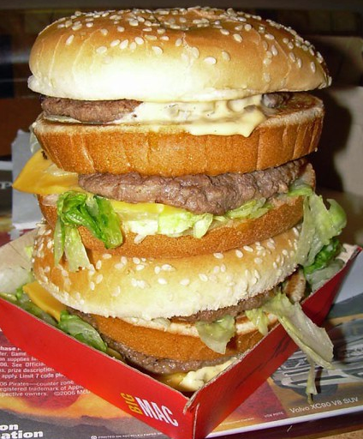
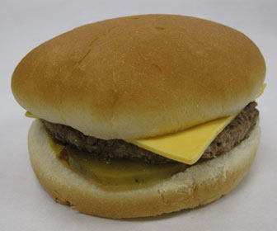
Knowledge Sabotage – Key Insights
Expectation…
Reality…

Slide 13
Knowledge Sabotage – Key Insights
Expectation…
Reality…

Slide 14
Knowledge Sabotage – Key Insights
Knowledge sabotage is very common!
40% of employees engaged in knowledge sabotage
54% have been a victim of knowledge sabotage
It’s everywhere – not limited to knowledge workers
Employees mostly act against their fellow co-workers
Rarely against their organizations!
Why?
Interpersonal conflict, envy, and retaliation!

Slide 15
Knowledge Sabotage – Key Insights
 | Saboteurs | Targets
View Themselves | Completely innocent Victims of the targets’ poor behavior and performance | Completely innocent Victims of knowledge sabotage
View their Opponents | Exhibiting negative, hostile, and disruptive behavior Causing harm to others Lazy and unproductive Incompetent Unhelpful | Spiteful, selfish, and egoistic Lazy Extremely envious Disliking others Conflict-prone Having mental issues
Motivation | To punish those who deserve it | To punish the innocent

Slide 16
Knowledge Sabotage – Key Insights
Consequences for the victims
Humiliated
Reprimanded
Terminated
Lost time!
Consequences for the saboteurs
Positive if the incident goes unreported
If reported and properly investigated
Reprimanded or terminated
Consequences for the organization
Loss of money, reputation, and human capital
Consequences for the third party

Slide 17
Knowledge Sabotage – Key Insights
Some of the key drivers
Negative personal traits
Competitiveness

Slide 18
Knowledge Sabotage – Key Insights

Slide 19
Counterproductive Knowledge Behavior
Knowledge hiding
Knowledge hoarding
Disengagement from knowledge sharing
Knowledge sharing ignorance
Partial knowledge sharing
Counter-knowledge sharing
Knowledge sabotage

Slide 20
Counterproductive Knowledge Behavior
PPT slides are available at aserenko.com

Slide 21
Counterproductive Knowledge Behavior
 | Disengagement from knowledge sharing | Knowledge sharing ignorance | Partial knowledge sharing | Knowledge hoarding | Counter-knowledge sharing | Knowledge hiding | Knowledge sabotage
Intention | Yes/No | Yes/No | Yes | Yes | Yes/No | Yes | Yes
Need awareness | No | No | No | No | No | Yes | Yes
Knowledge possession | No | No | Yes | Yes | No | Yes | Yes
Knowledge importance | No | No | No | No | No | No | Yes
Knowledge importance awareness | No | No | No | No | No | No | Yes
Knowledge application | No | No | No | No | No | No | Yes
Negative impact on an organization | Small | Small | Medium | Medium | Strong | Strong | Very strong
Google Scholar Hits | 72 | 5 | 144 | 2,570 | 121 | 1,840 | 12

